Slide 1

EIE4512 - Digital Image Processing More Image Segmentation Methods
Zhen Li lizhen@cuhk.edu.cn
School of Science and Engineering
The Chinese University of Hong Kong, Shen Zhen May 7-9, 2019

Slide 2
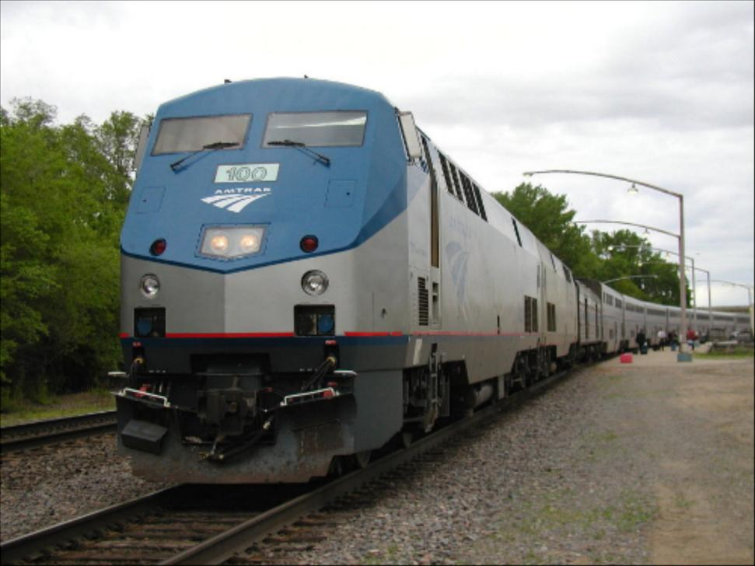
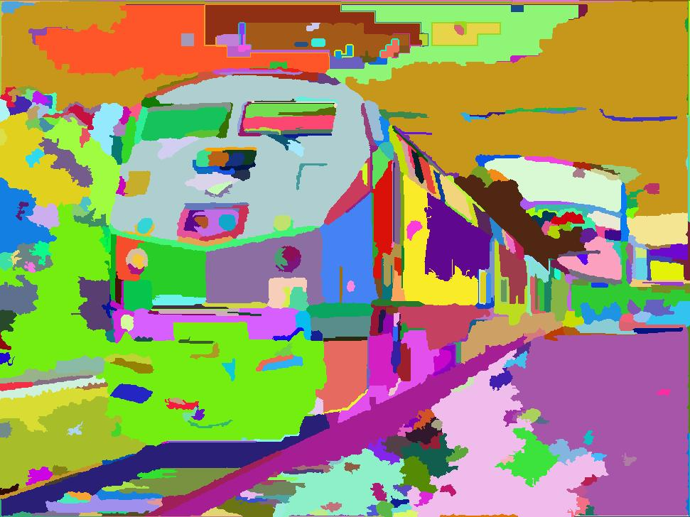
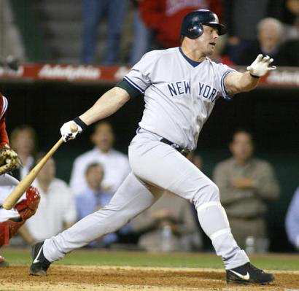
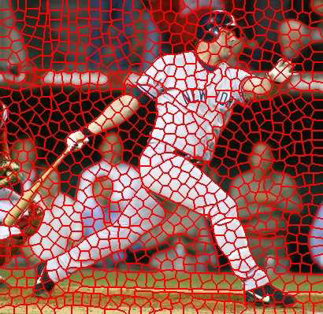
Segmentation for efficiency: “superpixels”
[Felzenszwalb and Huttenlocher 2004]
[Shi and Malik 2001]
[Hoiem et al. 2005, Mori 2005]

Slide 3
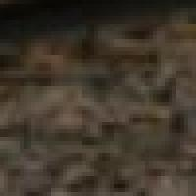

Segmentation for feature support
50x50 Patch
50x50 Patch

Slide 4
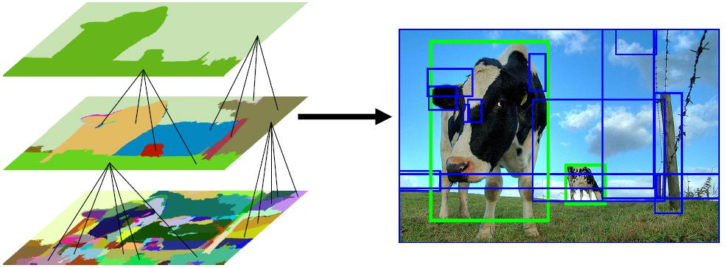
Segmentation for object proposals
“Selective Search” [Sande, Uijlings et al. ICCV 2011, IJCV 2013]
[Endres Hoiem ECCV 2010, IJCV 2014]

Slide 5
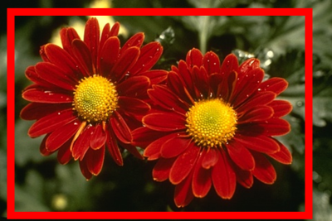
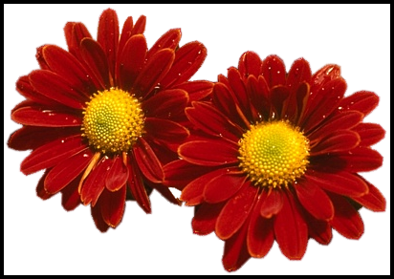
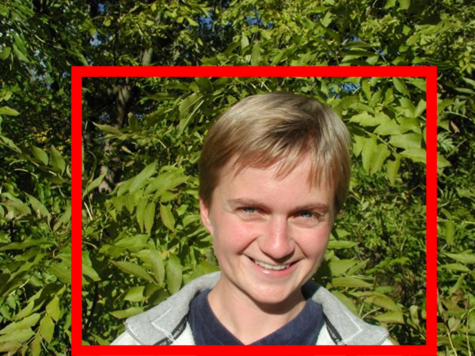
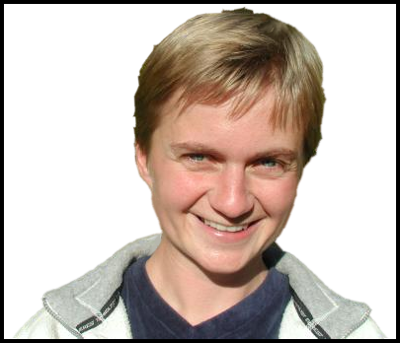
Segmentation as a result
Rother et al. 2004

Slide 6
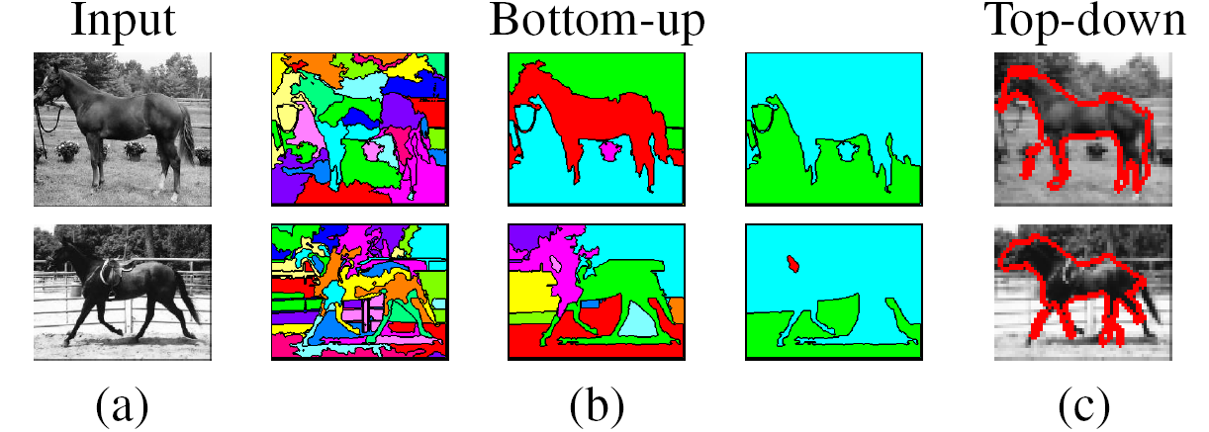
Types of segmentations
Oversegmentation
Undersegmentation
Multiple Segmentations

Slide 7
Major processes for segmentation
Bottom-up: group tokens with similar features
Top-down: group tokens that likely belong to the same object
[Levin and Weiss 2006]

Slide 8
Segmentation using clustering
Kmeans
Mean-shift

Slide 9
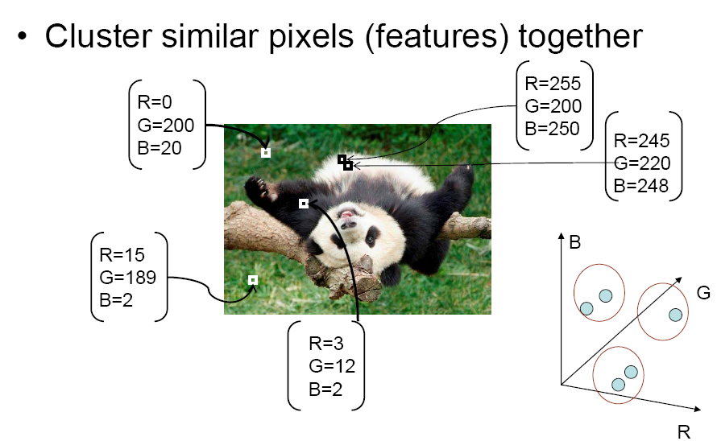
Feature Space
Source: K. Grauman

Slide 10
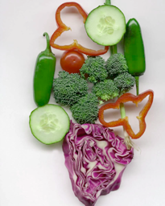
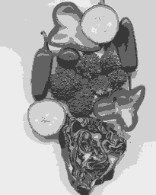
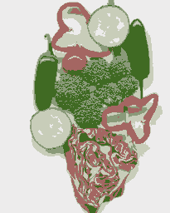
K-means clustering using intensity alone and color alone
Image
Clusters on intensity
Clusters on color
Notes:
I gave each pixel the mean intensity or mean color of its cluster --- this is basically just vector quantizing the image intensities/colors. Notice that there is no requirement that clusters be spatially localized and they’re not.

Slide 11
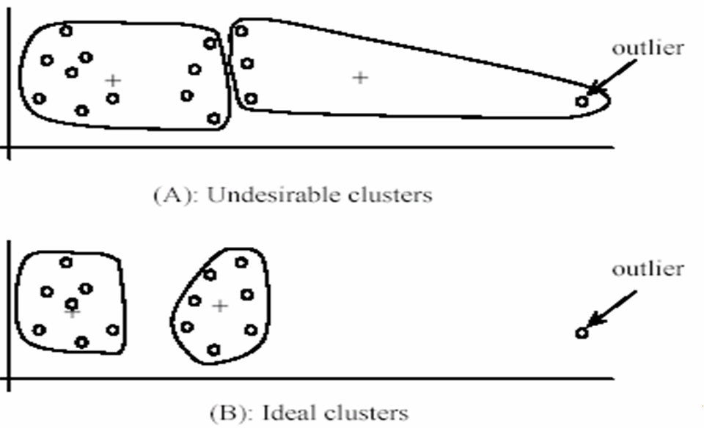
K-Means pros and cons
Pros
Simple and fast
Easy to implement
Cons
Need to choose K
Sensitive to outliers
Usage
Rarely used for pixel segmentation

Slide 12
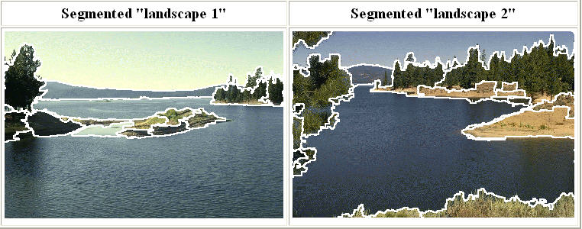
Mean shift segmentation
D. Comaniciu and P. Meer, Mean Shift: A Robust Approach toward Feature Space Analysis, PAMI 2002.
Versatile technique for clustering-based segmentation

Slide 13
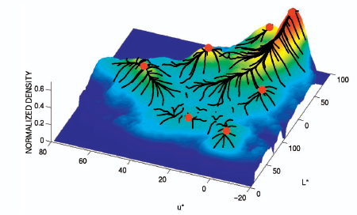
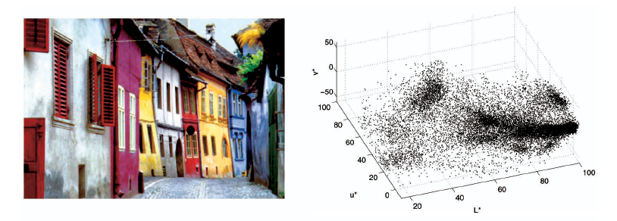
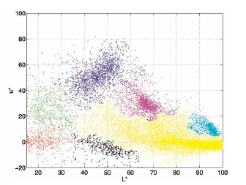
Mean shift algorithm
Try to find modes of this non-parametric density

Slide 14
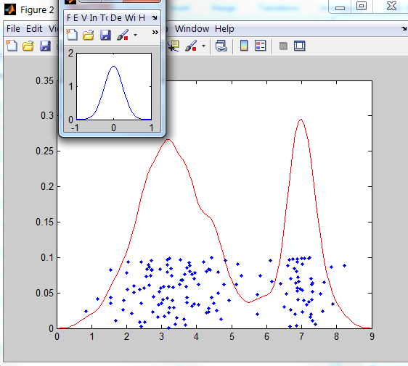
Kernel density estimation
Kernel
Estimated density
Data (1-D)

Slide 15
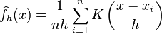
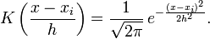
Kernel density estimation
Kernel density estimation function
Gaussian kernel

Slide 16
Mean shift
Region of
interest
Center of
mass
Mean Shift
vector
Slide by Y. Ukrainitz & B. Sarel

Slide 17
Mean shift
Region of
interest
Center of
mass
Mean Shift
vector
Slide by Y. Ukrainitz & B. Sarel

Slide 18
Mean shift
Region of
interest
Center of
mass
Mean Shift
vector
Slide by Y. Ukrainitz & B. Sarel

Slide 19
Mean shift
Region of
interest
Center of
mass
Mean Shift
vector
Slide by Y. Ukrainitz & B. Sarel

Slide 20
Mean shift
Region of
interest
Center of
mass
Mean Shift
vector
Slide by Y. Ukrainitz & B. Sarel

Slide 21
Mean shift
Region of
interest
Center of
mass
Mean Shift
vector
Slide by Y. Ukrainitz & B. Sarel

Slide 22
Mean shift
Region of
interest
Center of
mass
Slide by Y. Ukrainitz & B. Sarel

Slide 23
Computing the Mean Shift
Simple Mean Shift procedure:
Compute mean shift vector
Translate the Kernel window by m(x)
Slide by Y. Ukrainitz & B. Sarel

Slide 24
Real Modality Analysis

Slide 25
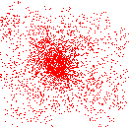
Attraction basin
Attraction basin: the region for which all trajectories lead to the same mode
Cluster: all data points in the attraction basin of a mode
Slide by Y. Ukrainitz & B. Sarel

Slide 26
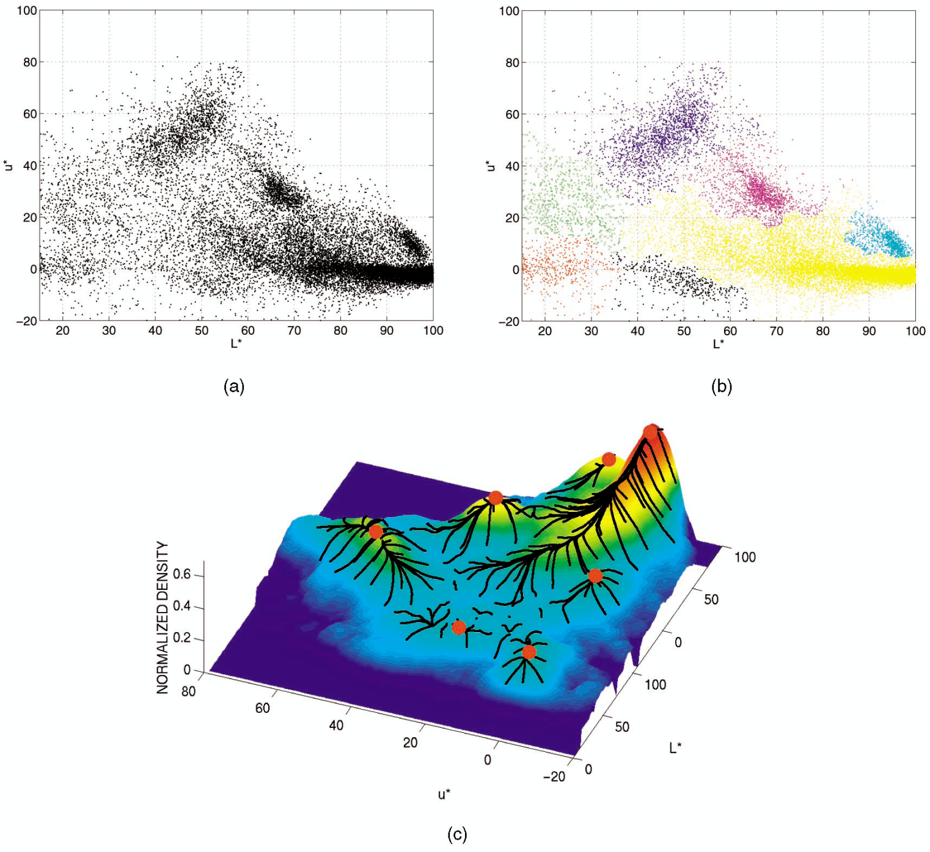
Attraction basin

Slide 27
Mean shift clustering
The mean shift algorithm seeks modes of the given set of points
Choose kernel and bandwidth
For each point:
Center a window on that point
Compute the mean of the data in the search window
Center the search window at the new mean location
Repeat (b,c) until convergence
Assign points that lead to nearby modes to the same cluster

Slide 28

Segmentation by Mean Shift
Compute features for each pixel (color, gradients, texture, etc); also store each pixel’s position
Set kernel size for features K_{f} and position K_{s}
Initialize windows at individual pixel locations
Perform mean shift for each window until convergence
Merge modes that are within width of K_{f} and K_{s}

Slide 29
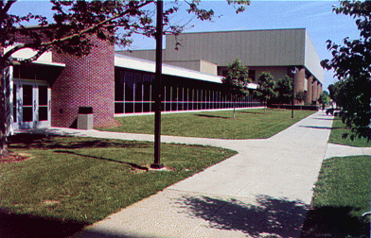
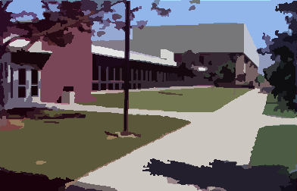
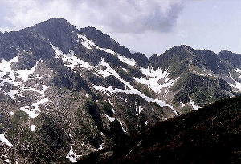
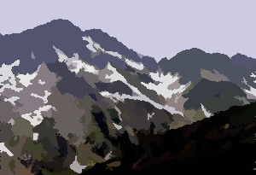
Mean shift segmentation results
http://www.caip.rutgers.edu/~comanici/MSPAMI/msPamiResults.html

Slide 30
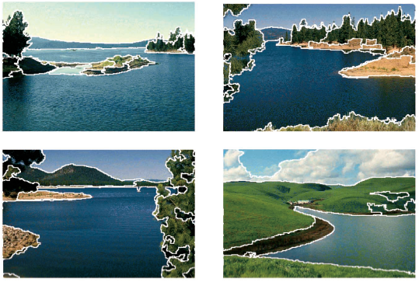
http://www.caip.rutgers.edu/~comanici/MSPAMI/msPamiResults.html

Slide 31
Mean-shift: other issues
Speedups
Binned estimation – replace points within some “bin” by point at center with mass
Fast search of neighbors – e.g., k-d tree or approximate NN
Update all windows in each iteration (faster convergence)
Other tricks
Use kNN to determine window sizes adaptively
Lots of theoretical support
D. Comaniciu and P. Meer, Mean Shift: A Robust Approach toward Feature Space Analysis, PAMI 2002.

Slide 32
Mean shift pros and cons
Pros
Good general-purpose segmentation
Flexible in number and shape of regions
Robust to outliers
General mode-finding algorithm (useful for other problems such as finding most common surface normals)
Cons
Have to choose kernel size in advance
Not suitable for high-dimensional features
When to use it
Oversegmentation
Multiple segmentations
Tracking, clustering, filtering applications
D. Comaniciu, V. Ramesh, P. Meer: Real-Time Tracking of Non-Rigid Objects using Mean Shift, Best Paper Award, IEEE Conf. Computer Vision and Pattern Recognition (CVPR'00), Hilton Head Island, South Carolina, Vol. 2, 142-149, 2000

Slide 33
Mean-shift reading
Nicely written mean-shift explanation (with math)
http://saravananthirumuruganathan.wordpress.com/2010/04/01/introduction-to-mean-shift-algorithm/
Includes .m code for mean-shift clustering
Mean-shift paper by Comaniciu and Meer
http://www.caip.rutgers.edu/~comanici/Papers/MsRobustApproach.pdf
Adaptive mean shift in higher dimensions
http://mis.hevra.haifa.ac.il/~ishimshoni/papers/chap9.pdf

Slide 34
Superpixel algorithms
Goal is to divide the image into a large number of regions, such that each regions lie within object boundaries
Examples
Watershed
Felzenszwalb and Huttenlocher graph-based
Turbopixels
SLIC

Slide 35
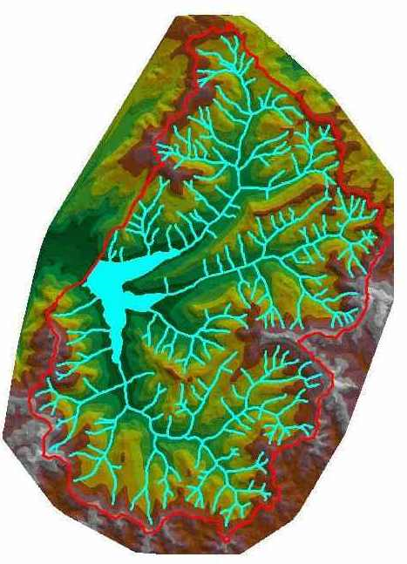
Watershed algorithm

Slide 36

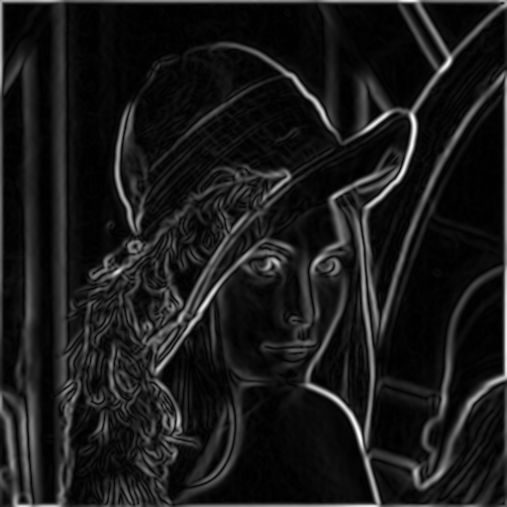
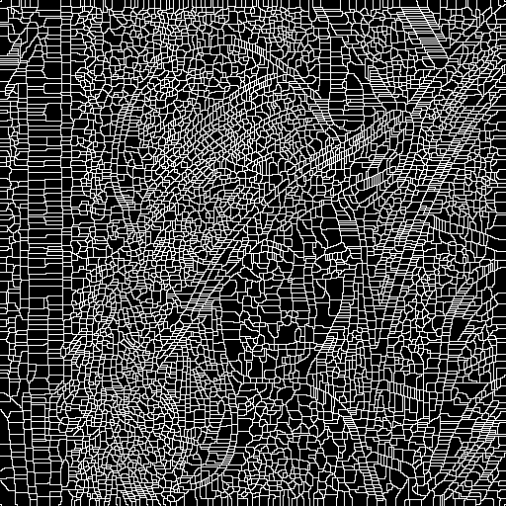
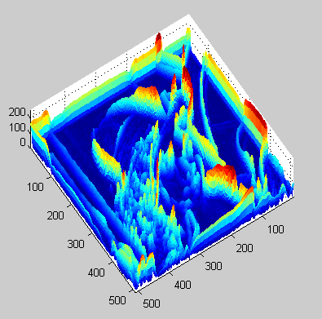
Watershed segmentation
Image
Gradient
Watershed boundaries

Slide 37
Meyer’s watershed segmentation
Choose local minima as region seeds
Add neighbors to priority queue, sorted by value
Take top priority pixel from queue
If all labeled neighbors have same label, assign that label to pixel
Add all non-marked neighbors to queue
Repeat step 3 until finished (all remaining pixels in queue are on the boundary)
Matlab: seg = watershed(bnd_im)
Meyer 1991

Slide 38
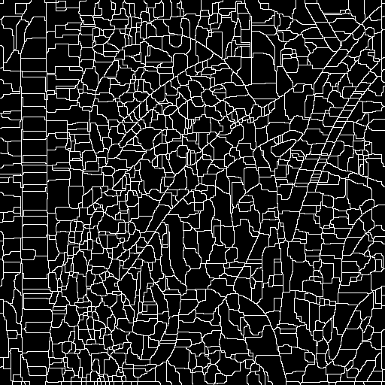
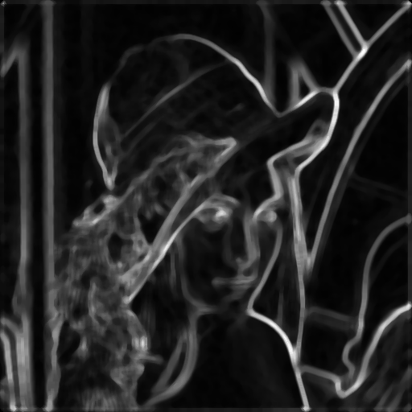
Simple trick
Use Gaussian or median filter to reduce number of regions

Slide 39
Watershed usage
Use as a starting point for hierarchical segmentation
Ultrametric contour map (Arbelaez 2006)
Works with any soft boundaries
Canny (w/o non-max suppression)
Etc.

Slide 40
Watershed pros and cons
Pros
Fast (< 1 sec for 512x512 image)
Preserves boundaries
Cons
Only as good as the soft boundaries (which may be slow to compute)
Not easy to get variety of regions for multiple segmentations
Usage
Good algorithm for superpixels, hierarchical segmentation

Slide 41
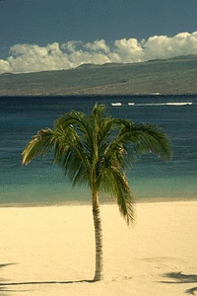
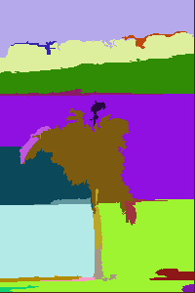
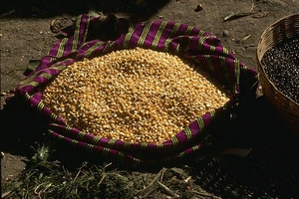
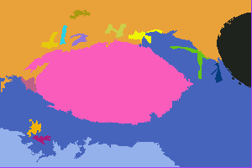
Felzenszwalb and Huttenlocher: Graph-Based Segmentation
http://www.cs.brown.edu/~pff/segment/
+ Good for thin regions
+ Fast
+ Easy to control coarseness of segmentations
+ Can include both large and small regions
- Often creates regions with strange shapes
- Sometimes makes very large errors

Slide 42
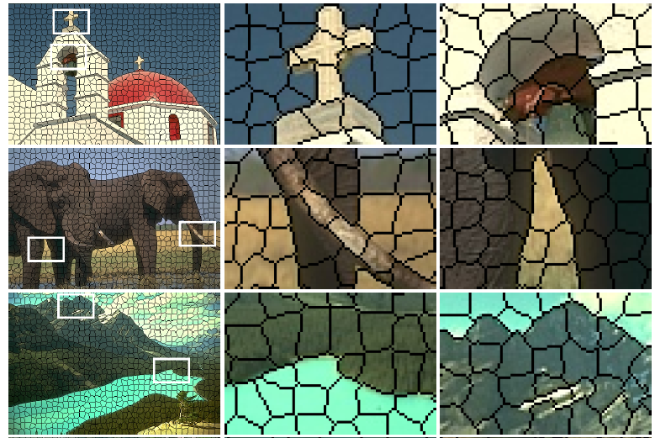
Turbo Pixels: Levinstein et al. 2009
http://www.cs.toronto.edu/~kyros/pubs/09.pami.turbopixels.pdf
Tries to preserve boundaries like watershed but to produce more regular regions

Slide 43
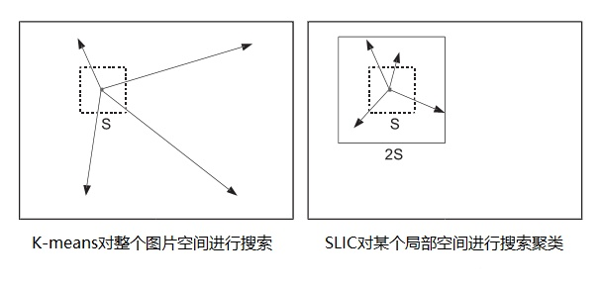
SLIC (Achanta et al. PAMI 2012)
http://infoscience.epfl.ch/record/177415/files/Superpixel_PAMI2011-2.pdf
Initialize cluster centers on pixel grid in steps S and equally distributed k cluster centers
- Features: Lab color, x-y position
Move centers to position in 3x3 window with smallest gradient (smoothest point)
Compare each pixel to cluster center within 2S pixel distance and assign to nearest
Recompute cluster centers as mean color/position of pixels belonging to each cluster
Stop when residual error is small
+ Fast 0.36s for 320x240
+ Regular superpixels
+ Superpixels fit boundaries
- May miss thin objects
- Large number of superpixels

Slide 44
Jianbo Shi’s Graph-Partitioning
An image is represented by a graph whose nodes
are pixels or small groups of pixels.
The goal is to partition the vertices into disjoint sets so
that the similarity within each set is high and
across different sets is low.

Slide 45
Minimal Cuts
Let G = (V,E) be a graph. Each edge (u,v) has a weight w(u,v)
that represents the similarity between u and v.
Graph G can be broken into 2 disjoint graphs with node sets
A and B by removing edges that connect these sets.
Let cut(A,B) = ∑ w(u,v).
One way to segment G is to find the minimal cut.
uεA, vεB

Slide 46
Cut(A,B)
cut(A,B) = ∑ w(u,v).
uεA, vεB
B
A
w1
w2

Slide 47
Normalized Cut
Minimal cut favors cutting off small node groups,
so Shi proposed the normalized cut.
cut(A, B) cut(A,B)
Ncut(A,B) = ------------- + -------------
asso(A,V) asso(B,V)
normalized
cut
asso(A,V) = ∑ w(u,t)
u∈A, t∈V
How much is A connected
to the graph as a whole.

Slide 48
Example Normalized Cut
A
B
2
2
2
2
2
2
2
2
1
4
3
1
2
2
2
3
3 3
Ncut(A,B) = ------- + ------
21 16

Slide 49
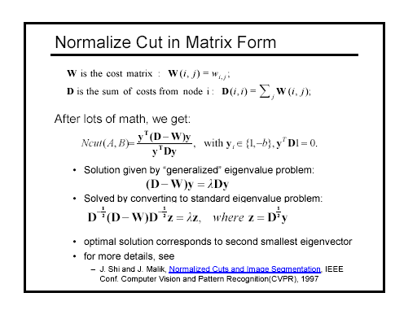

Slide 50
How Shi used the procedure
Shi defined the edge weights w(i,j) by
w(i,j) = e *
||X(i)-X(j)||2 / σX
||F(i)-F(j)||2 / σI
e if ||X(i)-X(j)||2 < r
0 otherwise
where X(i) is the spatial location of node i
F(i) is the feature vector for node I
which can be intensity, color, texture, motion…
The formula is set up so that w(i,j) is 0 for nodes that
are too far apart.

Slide 51
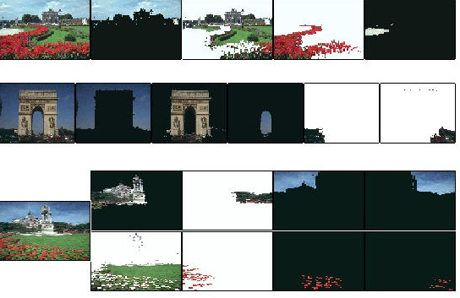
Examples of Shi Clustering
See Shi’s Web Page
http://www-2.cs.cmu.edu/~jshi

Slide 52
Markov Random Fields
Node y_{i}: pixel label
Edge: constrained pairs
Cost to assign a label to each pixel
Cost to assign a pair of labels to connected pixels

Slide 53
Markov Random Fields
Unary potential
Example: “label smoothing” grid
0: -logP(y_{i} = 0 | data)
1: -logP(y_{i} = 1 | data)
Pairwise Potential
0 1
0 0 K
1 K 0
K>0

Slide 54
Solving MRFs with graph cuts
Source (Label 0)
Cost to assign to 1
Cost to split nodes
Cost to assign to 0
Sink (Label 1)

Slide 55
Solving MRFs with graph cuts
Source (Label 0)
Cost to assign to 1
Cost to split nodes
Cost to assign to 0
Sink (Label 1)

Slide 56
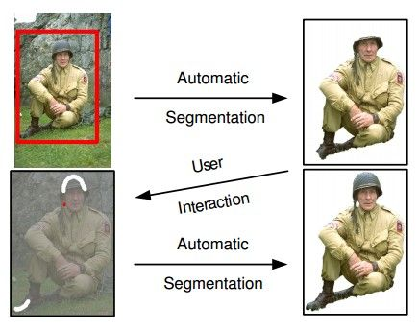
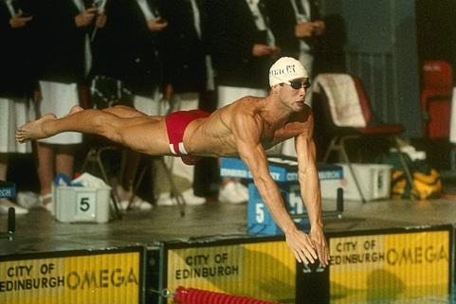
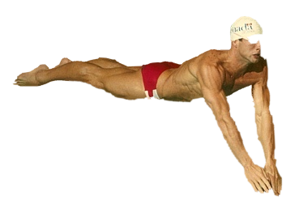
GrabCut segmentation
User provides rough indication of foreground region.
Goal: Automatically provide a pixel-level segmentation.

Slide 57
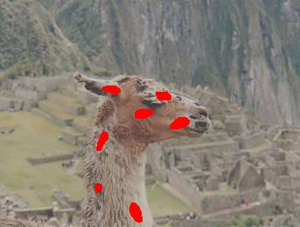
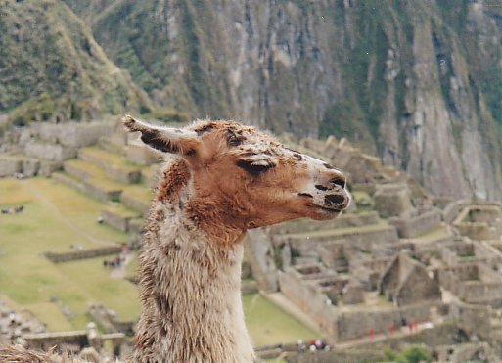
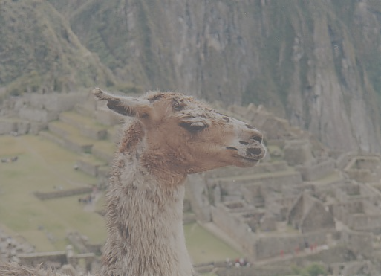



Grab cuts and graph cuts
Magic Wand (198?)
Intelligent Scissors Mortensen and Barrett (1995)
GrabCut
User Input
Result
Regions
Boundary
Regions & Boundary
Source: Rother
Notes:
Basic idea is to combine the information which was used in the 2 well known tools: MW and IS.
MS select a region of similar colour according to your input. Fat pen and the boundary snapps to high contrast edges.
Grabcut combines it. And this allows us to simplify the user interface considerably by …

Slide 58

Graph cuts Boykov and Jolly (2001)
Foreground (source)
Image
Min Cut
Background (sink)
Cut: separating source and sink; Energy: collection of edges
Min Cut: Global minimal energy in polynomial time
Source: Rother
Notes:
Optimization engine we use Graph Cuts. By now everybody should know what graph cut is. IN case you missed it here is a very brief introduction.
To image. 3D view. First task to construct a graph.
All pixels on a certain scanline. Just a few of them.
Next step introduce artificial nodes. fgd and background.
Edges – contrast. Boundary is quite likely between black and white.
Min Cut - Minimum edge strength.

Slide 59
GrabCut segmentation
Define graph
usually 4-connected or 8-connected
Divide diagonal potentials by sqrt(2)
Define unary potentials
Color histogram or mixture of Gaussians for background and foreground
Define pairwise potentials
Apply graph cuts
Return to 2, using current labels to compute foreground, background models

Slide 60





What is easy or hard about these cases for graphcut-based segmentation?

Slide 61




Easier examples
GrabCut – Interactive Foreground Extraction 10
Notes:
Moderately straightforward examples- after the user input automnatically

Slide 62



More difficult Examples
Camouflage &
Low Contrast
Fine structure
Harder Case
Initial Rectangle
Initial Result
GrabCut – Interactive Foreground Extraction 11
Notes:
You might wonder when does it fail. 4 cases. Low contrats – an edge not good visible

Slide 63
Graph cuts: Pros and Cons
Pros
Very fast inference
Can incorporate data likelihoods and priors
Applies to a wide range of problems (stereo, image labeling, recognition)
Cons
Not always applicable (associative only)
Need unary terms (not used for bottom-up segmentation, for example)
Use whenever applicable

Slide 64
Choices in segmentation algorithms
Oversegmentation
Watershed + Pb ← my favorite
Felzenszwalb and Huttenlocher 2004 ← my favorite
http://www.cs.brown.edu/~pff/segment/
SLIC ← good recent option
Turbopixels
Mean-shift
Larger regions
Hierarchical segmentation ← my favorite
Normalized cuts
Mean-shift
Seed + graph cuts

Slide 65


Things to remember
Uses of segmentation
Efficiency
Better features
Propose object regions
Want the segmented object
Mean-shift segmentation
Good general-purpose segmentation method
Generally useful clustering, tracking technique
Watershed segmentation
Good for hierarchical segmentation
Use in combination with boundary prediction
Grabcut and MRF/CRF
Very fast interactive inference
Applies to a wide range of problems

Slide 66


Semantic Segmentation
http://mscoco.org/dataset/#detections-challenge2016
https://www.cityscapes-dataset.com/examples/#fine-annotations

Slide 67

Semantic Segmentation
http://cs.nyu.edu/~silberman/datasets/nyu_depth_v2.html

Slide 68
Example detections and instance segmentations

Slide 69
Example detections and instance segmentations

Slide 70
Example keypoint detections

Slide 71
What if you want to label every pixel?
“Stuff” can be hard to capture with bounding boxes
https://www.cityscapes-dataset.com/examples/#fine-annotations

Slide 72
Fully convolutional networks for semantic segmentation – Long Shelhamer Darrel 2015
Use network trained for classification as pre-trained network for pixel labeling
Convert fully connected layers into convolutions
Add features from earlier conv layers to improve resolution
Fine-tune for pixel labeling task
224x224
500x500

Slide 73
“Fully convolutional” results
Takes advantage of pre-training from classification
Applied to objects and scenes (NYUd v2)
But feature pooling reduces spatial sensitivity and resolution

Slide 74
Dilated Convolutions – Yu Kolton 2016
Replacing last two pooling layers with “dilated convolution” that filters a sparse 3x3 grid of pixels
Enables large receptive field with few parameters
Improves resolution

Slide 75
Dilated Convolutions results

